Slide 1
Section 2

Slide 2
Commits and branches
new_feature
new_feature
new_feature
Merge new_feature into main
main
main
1
2
3
main
main
Switch to a new branch
Notes:
We will start discussing the main Git concepts, starting with commits and branches. This will show
- how git works as a version control system, and
- what the development workflow looks like
To understand Git, we can represent a project as a blob – this is the current state of all the files in the project folder. We’ll label the first blob as 1. (In reality, the ID is a long hexadecimal string called a hash.)
A blob is called a commit.
We can make some changes to the files and make a second commit. Now the project looks like version 2, but version 1 is saved in git and you could look at the files how they were in version 1, or swtich back to it completely.
A project can go off on tangents, say to add new features. Each tangent is called a branch. By default, Git labels your initial branch "main". Technically, a branch itself is a label that points to one commit, but moves along as new commits are added to the chain it tracks.
If you want to work on a new feature. you can create a new branch. Here we create a new branch called new_feature. The new branch starts as just a new pointer to the current commit. But now if you add more commits, they will be added to the new_feature branch.
While you are working on your feature branch, you (or a colleague) might make changes to the main branch, so the branches will diverge - each branch contains changes that the other does not have.
Eventually, once your feature is complete, you can tell Git to merge it back into the main branch. Git handles this merge process so that the main branch then contains all the changes from both branches. If there are conflicting changes, Git will require you to resolve them manually.
Branches are a powerful feature of Git. An important benefit is they allow multiple people to work on separate features at the same time, each working on a separate branch. Git then handles the process of merging all the changes together (although some manual work might be needed if there are conflicts, for example where two branches both try to modify the same section of a file).

Slide 3
Synchronising with GitHub
GitHub remote repo
feature_1
“Pull request”
Merge
main
main
main
Merge
main
“Pull request”
Kristina’s local copy of
the repo on the AP
“Push”
feature_2
“Push”
Ian’s local copy of
the repo on the AP
“Pull”
“Pull”
“Clone”
“Clone”
feature_1
feature_1
main
main
main
main
main
feature_2
feature_2
Notes:
GitHub is the web service that hosts the central, shared version of your project, that everyone can replicate and work on, and then contribute their changes to.
The project folder on GitHub is called a repository, or repo.
Let’s illustrate how colleagues can collaborate using GitHub, to share and synchronise their work.
We start with a repo created on GitHub. (The AP guidance tells you how to create a repo). The repo has a couple of commits in it already.
Then Kristina wants to contribute to the repo. So she Clones the repo to make a copy of it in her Analytical Platform area (again following the AP guidance.)
Ian also wants to contribute so he does the same and clones the repo.
Kristina decides to add a feature. So she creates a branch called feature_1, so that her new feature will be isolated from the main branch until it is complete. Then she does some work to implement the new feature in a series of commits. When it is finished, she ”pushes” her new_feature branch to the remote GitHub repo and it appears there for everyone to see. Note that it doesn’t yet appear on Ian’s repo – he will need to use the “Pull” command at some point to update his local repo.
Now Ian decides to add a different feature, so he creates a branch, feature_2, branching off from a different commit on the "main" branch, and makes a series of commits until the feature is complete, and then he “pushes” the branch to GitHub.
Now the GitHub repo has all three branches as separate branches, and Kristina and Ian want their features to be merged into the “main” branch.
The way to do that is by creating a “Pull request” on GitHub. That creates a page on GitHub with features to discuss and review code, so other team members can review the code in each feature branch before it gets merged into main.
Kristina opens a pull request for the feature_1 branch. Once the review process is complete - a team-mate probably approves the pull request - she merges it into main. Now main contains the work from feature_1.
Ian also opens a pull request for the feature_2 branch and that gets reviewed and then he merges it into main, so the “main” branch now contains both features.
The last thing here is that both Kristina and Ian need to update their local copies of the repo, which is done using the “pull” command. Kristina pulls from GitHub to update her repo, and so does Ian, and now their copies of the repo are both up to date and they can repeat the process.

Slide 4
File states
Working directory
Stage
Staging area
Commit
Commit history
The project directory in your file system containing your saved files.
Modified files marked to be added to the next commit.
Can be all modified files or a selection.
Files can be unstaged.
Stored commits - snapshots of the project.
Saved in the .git directory.
Notes:
Having looked at the big picture, we will now discuss the steps in making a commit.
There are three states a file can be in with git.
When you do a regular file save, the file is saved in your working directory as usual.
Git will notice if a file has changed and flag it.
If you want to add the change to a commit, you tell git to add the file to the “staging area”
You can add multiple files and changes to the staging area. You add files until you have added all the changes you want to bundle up into a commit. Typicallly, a commit will be a small, self-contained change to the code.
Once you have all the changes you want in the staging area, you make a commit. That adds your commit to the commit history, making it a saved snapshot in your project history, saved in the .git directory.

Slide 5


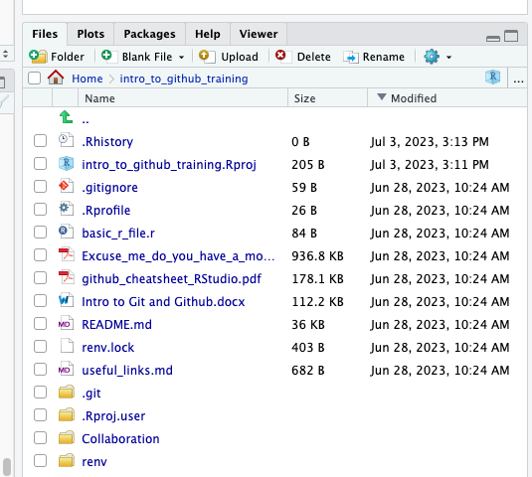
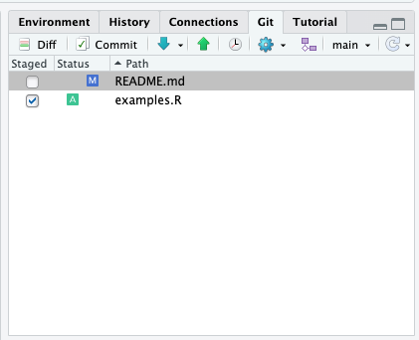
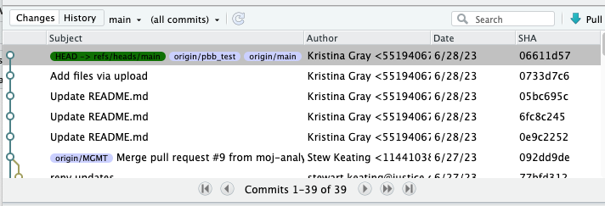
File states
Working directory
Stage
Staging area
Commit
Commit history
?
An untracked file – a file that has not yet been
staged or committed.
M
A file that has been modified
A
A file that has been added to the staging area.
D
A file that has been deleted.
R
A file that has been renamed.
Notes:
View the working directory in the files pane
View the staging area in the git pane
View the commit history in the git history window

Slide 6
File states
git status
git status
git log
Working directory
Stage
Staging area
Commit
Commit history
git add
git commit
Notes:
To view the state of the working directory and staging area: git status
To view the commit history: git log
To stage files: git add
To commit everything in the staging area: git commit

Slide 7
Glossary of Section 2
Git: A file snapshot system, localised on your computer
GitHub: Where the snapshot can be saved on the internet (for sharing)
Repo: The location of your files on GitHub
Staged: When a file is ready to be included in the next snapshot
Commit: Snapshot of the project included in .git file
Branch: A stream of commits, used to compartmentalise edits
Push: Send the snapshot to GitHub for others to use
Pull: Receive snapshot changes from a branch

Slide 8
Diagrams of Git
Working directory /
Working tree
Staging area
.git directory (Repository)
Working on edits to your files and code, such as in R-Studio
Saved and unsaved files ready to be added to the Staging area.
Files marked to be added to the next snapshot of the project.
Can be only selected files or all files.
Files can be unstaged
The version control.
We can look back and see previous versions of commits.
Where we pull the initial project from

Slide 9
Create/clone a repository "repo"
This is what your repo looks like when its first created. Empty, like creating a new folder on your computer
After you have added a file or if you cloned a repo, you will have files in that repo, represented here by a symbolic "blob". It’s the “main” branch, the source of your GitHub project.
Currently all your code and files are saved to this one branch, called "main" by default. We are going to use blobs to explain how a repo works, what GitHub does and how to work with repos and GitHub.

Slide 10
Commit 1.1: Updates
Commit 1
Here we are adding our first commit, meaning:
we have made changes to our branch
told Git to Stage the changes so they are included the next time we commit
and then committed (snapshot taken)
It isn’t good practice to make edits directly to “main" branch though, instead we use other “Branches” to avoid mishaps and mistakes in the "main" branch.

Slide 11
Stage 2.1: Make a branch
Commit 2.1
Commit 2
A branch is a tangent from "main" branch. We use branches write new code, update code, and/or add files to the GitHub repo without the risk of editing/deleting the “main” branch.
For the training lets call the new branch "blue". When creating your own branch try to follow these tips.
Use separators
Use words related to the development you are making
Be descriptive
Avoid long branch names
Be consistent
Commit 1.1
Commit 1

Slide 12
Commit 2
Commit 2.1
Particularly useful if several people are working from the same repo. You can have as many branches working on edits and updates as you want.
Commit 1
Commit 1.1

Slide 13
Commit 2
Commit 2.1
Particularly useful if several people are working from the same repo. You can have as many branches working on edits and updates as you want.
Commit 1
Commit 1.1
Commit 2.1
Commit 2.1

Slide 14
Commit 2.1
Commit 2
Let’s keep it simple with just one branch for the moment.
In this example, you have made a branch (Commit 2) and made some edits (Commit 2.1).
Let's have a closer look at what happens between Commit 2 and Commit 2.1
Commit 1.1
Commit 1

Slide 15
Commit 2
Commit 2.1
When we made Commit 2, it had all the code and files from “main” branch Commit 1.1
We then edit the files, write code, rewrite code, upload files, delete files, etc
When we are happy with our changes we "Stage" the changes, so the next time we commit, anything "Staged" is included. It is possible to make edits on several files, "Stage" some and not others.
If we are editing multiple files, it’s best to have a commit per file edited. We’ll come back to this shortly
When committing, we also have to include a comment detailing what the edits in the snapshot are.
We can also continue to edit, save again, and commit again, Staging and Committing does not prevent further work

Slide 16
Commit 2
Commit 2.1
Push 2.1
The commits haven’t gone anywhere yet, they are still only on your local computer.
Commits wait until a function called “Push” is used.
Commit 1.1
Any/All commits will be “Pushed” up to GitHub.
GitHub will then retain the changes.
Pushing to a branch will replace earlier versions of the branch on GitHub. This is why we use branches, to avoid the “main” branch being overwritten or changed unexpectedly.
Commit 1
Even if something is replaced because Git is a version control system we can always return to an earlier commit

Slide 17
Commit 2
Commit 2.1
Push 2.1
Commit 1.1
After the push Commit 2 has been updated with the edits in Commit 2.1
Commit 1

Slide 18
Commit 2
Commit 1
Commit 1.1
Lets tidy up the graphs and say the edits in Commit 1.1 were accepted into Commit 1 (the same as Commit 2 now has the edits for Commit 2.1)

Slide 19
Commit 1
Commit 2
Commit 1 (“main” branch) has a branch Commit 2 ("blue“ branch)
Commit 2 is an update to Commit 1 (let’s say it adds some extra functionality to Commit 1 code)
At this point, we are happy with Commit 2, and would like our edits to be considered as permanent changes to Commit 1
On GitHub we need to raise a pull request
This alerts someone responsible for Commit 1 “main” branch, that they should review the edits in Commit 2 and consider merging the two branches. This will overwrite “main” branch anywhere there is a change in Commit 2.

Slide 20
PULL REQUEST
Commit 1
Commit 2
There are a few outcomes here, at the basic level, the person responsible for Commit 1 will either accept or reject the changes.
A rule of thumb: the smaller the changes the more likely the request will be a success. If you have change many things, it will take a long time to quality assure and if any part of your change is rejected, the whole change might be reject. Try to keep branch changes small and to the point (where possible)

Slide 21
Commit 1
In this example, the changes from Commit 2 have been accepted into Commit 1. The “blue” branch can be deleted and we are left with the “main” branch like we had at the beginning. If we wanted to make any more changes we could create a new branch and go from there.

Slide 22
GUI steps

Slide 23
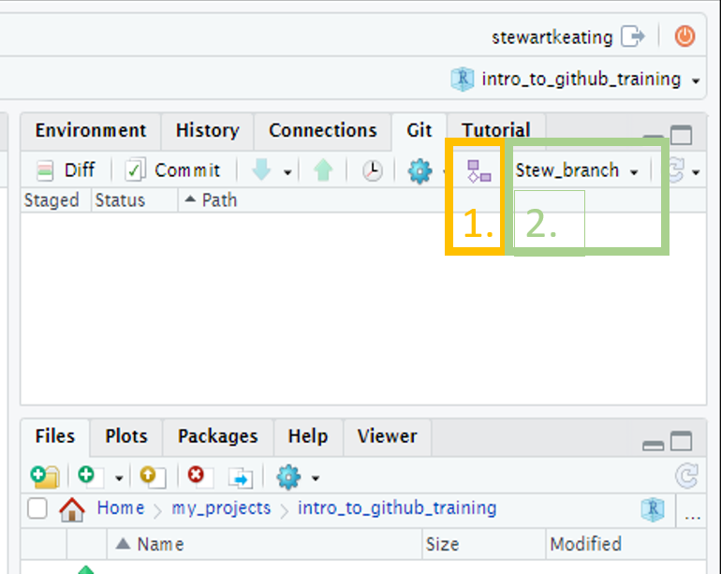
Section 2.1.2 Create a branch
GUI
Create a branch: click the “Git” tab on the right of R-Studio, then the small purple shapes on the right of the screen, add a branch name, and click create.
A pop-up will appear with a message that you have switched to a new branch, and the branch name will update in the Git pane. You can just close the pop-up.
(Note that if the “Sync branch with remote” checkbox is ticked the branch will also be created on the remote GitHub repo, removing the need to do that manually at a later stage.)

Slide 24
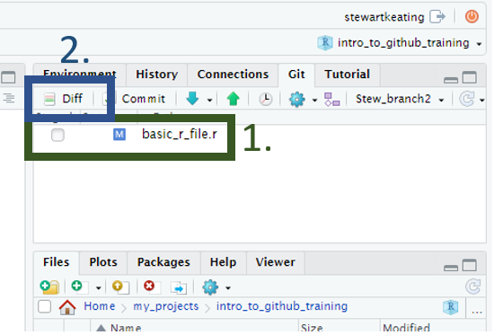
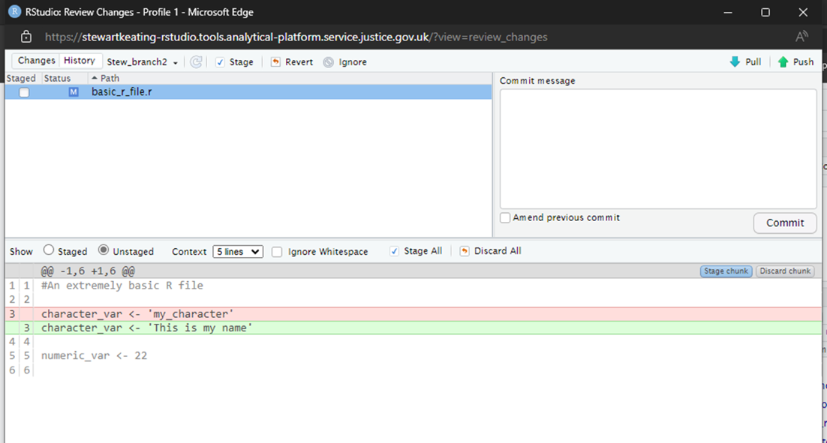
Section 2.2.1 Edit some files, for example write some code to an R script
GUI
If using the GUI, any files that have been edited and saved will appear in the git tab on the right-hand side of the screen. You can view the changes by pressing the Diff button and selecting the file name. Lines highlighted in red have been removed; lines highlighted in green have been added. Lines written in grey have not been changed. The left margin shows the line numbers of the code that has changed.

Slide 25
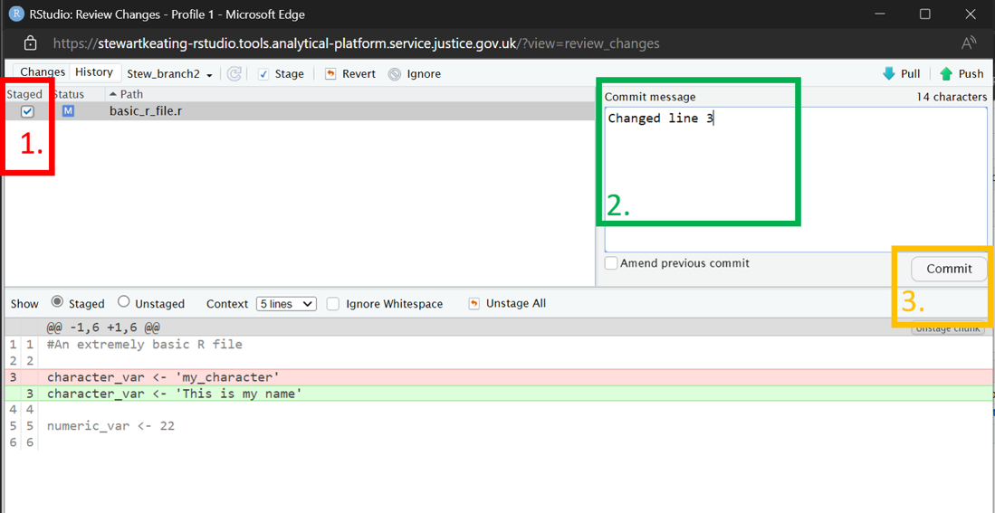
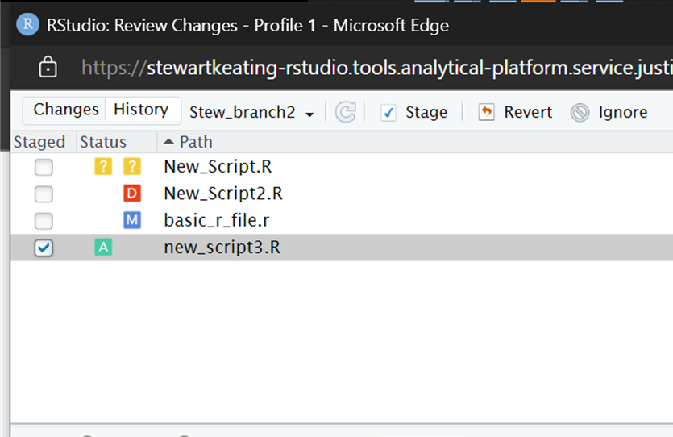
Section 2.2.2 Stage and commit a group of changes
GUI
Click either Diff or Commit to open the Review changes pop-up.
To stage a file, click the check box by the file name. Stage every file whose changes you would like to include in the commit.
Add a commit message in the commit message box.
Click the Commit button.
Changes to files can be seen in the status column.
?
An untracked file – a file that has not yet been staged or committed.
M
A file that has been modified
A
A file that has been added to the staging area.
D
A file that has been deleted.
R
A file that has been renamed.
In this example, the previous line 3 has been replaced by a new line 3.

Slide 26
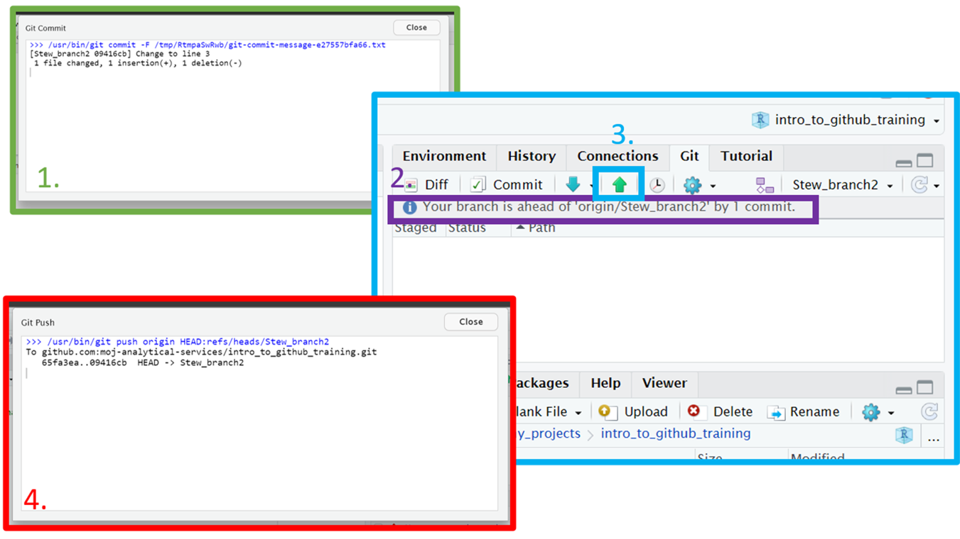
Section 2.3.1 Push changes
GUI
After committing, you will see a pop-up listing any changes, additions, deletions and the commit message.
Back on the main RStudio screen, you can see how commits ahead of the remote GitHub repo you are.
To push your changes to GitHub, click the up arrow.
You will see another pop-up confirming your branch has been updated on GitHub.

Slide 27
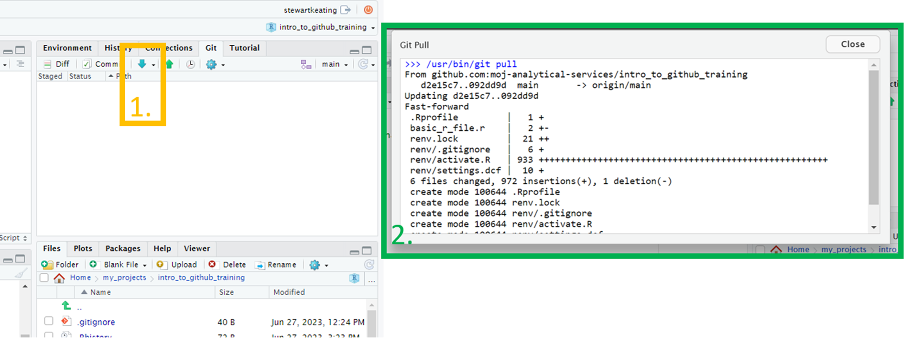
2.4 Pull changes into a local branch
GUI
After the merge has been accepted on GitHub, use the down arrow (next to the push arrow) to pull in the changes on GitHub.
A pop up will appear showing the changes.
In the GUI example screen shots, StewBranch2 was merged with Main branch. The local copy of Main Branch in R-Studio was updated by pulling the changes to Main Branch from GitHub.

Slide 28
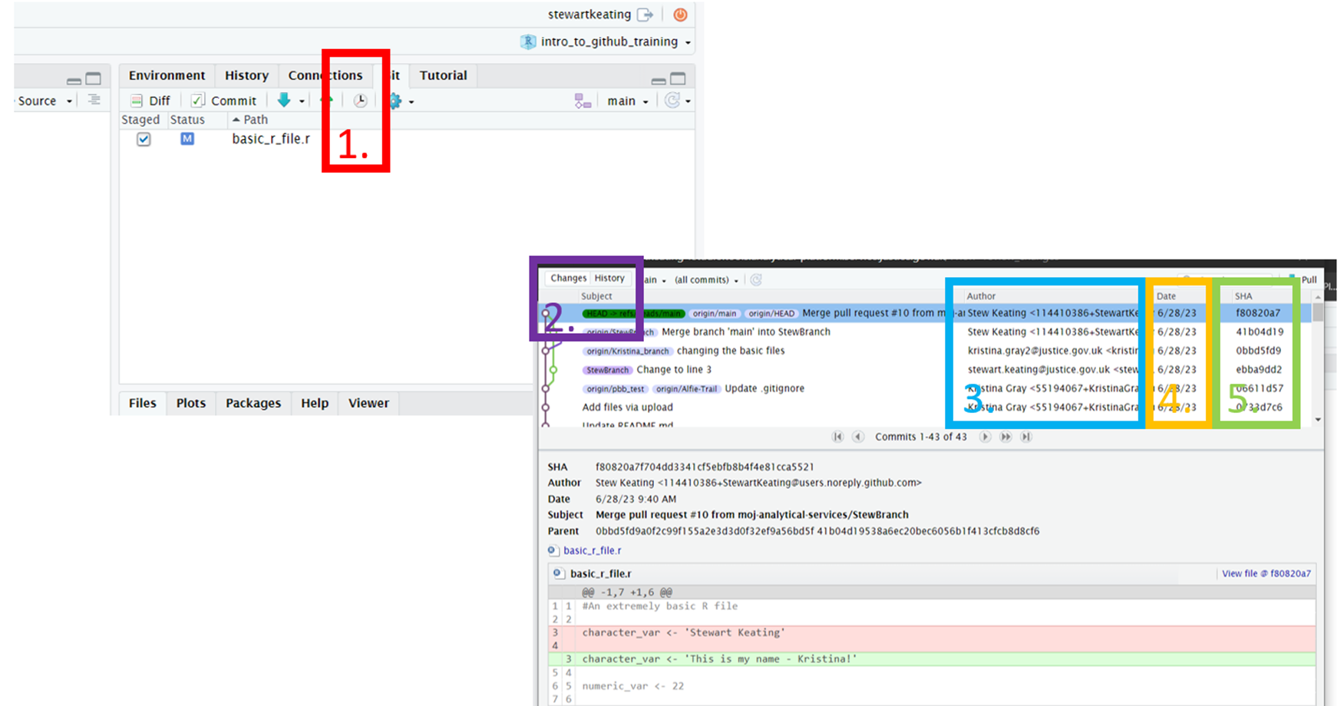
2.5 View the commit history
GUI
In the Rstudio Git pane, click on “History” to see the commit history for the current branch.
We can switch between the DIFF/COMMIT or HISTORY pop ups
3. The author of the commit
4. The date the commit took place
5. The unique ID for the commit

Slide 29
Terminal steps

Slide 30
Section 2.1.2 Create a branch
Terminal
Use the git status command before you create a new branch. git status displays the current state of your files and the staging area: what branch you’re on and which files have been modified or staged since the last commit.
To create a new branch:
git checkout –b my_branch

Slide 31
Section 2.2.1 Edit some files, for example write some code to an R script
Terminal
In the terminal, git status displays the current state of your files and the staging area.
You can also use the git diff command to show changes. Typing the command without any options shows the uncommitted changes since the last commit.

Slide 32
Section 2.2.2 Stage and commit a group of changes
Terminal
Use git add to add files to the staging area.
To stage a single file:
git add my_file.txt
To stage all modified files:
git add .
Use git commit to commit the staged files.
To commit the staged files and open a text editor in which to type the commit message:
git commit
To commit your changes and type an inline commit message (instead of opening the text editor):
git commit -m "My commit message"

Slide 33
Section 2.3.1 Push changes
Terminal
Use git push to push your branch to the remote repo.
To push to a branch that already exists on the remote repo:
git push
If your branch does not yet exist on the remote GitHub repo, the first time you push you will need to create a remote version:
git push –u origin my_branch
The option -u is a shortcut for --set-upstream, which creates a version of the branch on the remote repo.

Slide 34
2.4 Pull changes into a local branch
Terminal
If you are not currently on the main branch, switch to it with:
git checkout main
Use the git pull command to merge commits added to the remote branch into your local branch.

Slide 35
2.5 View the commit history
Terminal
The git log command shows the commit history for the current branch, starting with the most recent. The --oneline option is useful to condense the output. You can limit the number of commits shown with the – option.
For example, to see the most recent five commits on the current branch :
git log --oneline -5

